Slide 1


Amman Sajid
05/10/2024

Slide 2

Outline
Executive Summary
Introduction
Methodology
Results
Conclusion
Appendix

Slide 3
Executive Summary
Summary of methodologies
Summary of all results

Slide 4
Introduction
Space X advertises Falcon 9 rocket launches on its website with a cost of 62 million dollars; other providers cost upward of 165 million dollars each, much of the savings is because Space X can reuse the first stage. Therefore, if we can determine if the first stage will land, we can determine the cost of a launch. This information can be used if an alternate company wants to bid against space X for a rocket launch. This goal of the project is to create a machine learning pipeline to predict if the first stage will land successfully.
Problems you want to find answers
What factors determine if the rocket will land successfully?
The interaction amongst various features that determine the success rate of a successful landing.
What operating conditions needs to be in place to ensure a successful landing program.

Slide 5

Section 1

Slide 6
Methodology
Executive Summary
Data collection
Obtain SpaceX historic launch data using SpaceX API and web scraping Wikipedia page
Perform data wrangling
Cleaning data by dealing with missing values, removing unnecessary columns and transformation of categorical features into numeric.
Perform exploratory data analysis (EDA) using visualization and SQL
Perform interactive visual analytics using Folium and Plotly Dash
Perform predictive analysis using classification models
Data split into training and testing sets and machine learning models were trained using training data and then accuracy measured on testing data. Model parameters were also tuned to maximise performance.

Slide 7
Data Collection
The data was collected using various methods​
Data collection was done using get request to the SpaceX API.​
Next, we decoded the response content as a Json using .json() function call and turn it into a pandas dataframe using .json_normalize() method.​
We then cleaned the data, checked for missing values and fill in missing values where necessary.​
In addition, we performed web scraping from Wikipedia for Falcon 9 launch records with BeautifulSoup. ​
The objective was to extract the launch records as HTML table, parse the table and convert it to a pandas dataframe for further analysis.​

Slide 8
Data Collection – SpaceX API
Define SpaceX API URL endpoint
Make GET request using requests.get(spacex_url)
Decode response into JSON using response.json()
Convert JSON result into a Pandas data frame using pd.json_normalize(response.json())
By making GET request calls to the SpaceX API, the historic launch data was obtained, decoded into a JSON format and then converted into a data frame.
The link to the notebook is https://github.com/AmmanSajid1/IBM-Data-Science-Capstone-SpaceX-Project/blob/main/Data%20Collection%20API.ipynb

Slide 9
Data Collection - Scraping
Made GET request to Wikipedia URL using requests.get(static_url)
Created BeautifulSoup object: BeautifulSoup(response.text)
Found all HTML tables in the response using html_tables = soup.find_all('table')
After identifying the correct table, the table column names and row data were saved
These were used to create a Pandas data frame containing all scraped data
Applied web scrapping to a Wikipedia page to obtain Falcon 9 launch records with BeautifulSoup
Parsed the table and converted it into a pandas dataframe.
The link to the notebook is https://github.com/AmmanSajid1/IBM-Data-Science-Capstone-SpaceX-Project/blob/main/Data%20Collection%20with%20Web%20Scraping.ipynb

Slide 10

Data Wrangling
Exploratory data analysis (EDA) was done to determine the number of launches at each site and the occurrence of each orbit type.
Data processing was done to create labels from the outcome column by setting all successful launches as 1 and failed launches as 0.
The processed data frame was saved to a csv format to use for later analysis.
The link to the notebook is https://github.com/AmmanSajid1/IBM-Data-Science-Capstone-SpaceX-Project/blob/main/Data%20Wrangling.ipynb

Slide 11
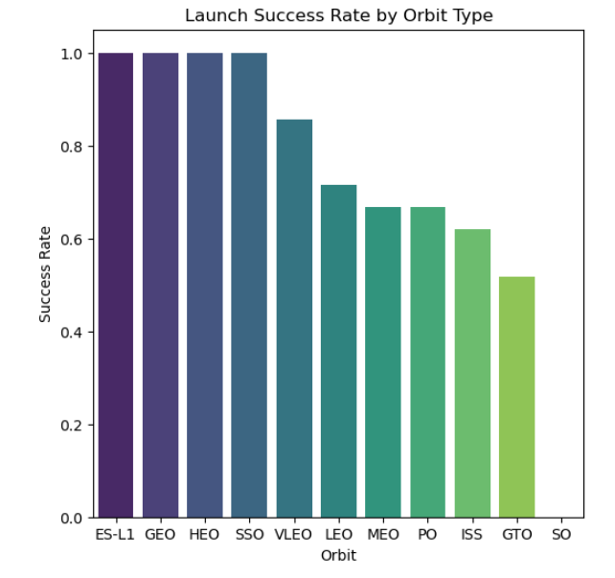
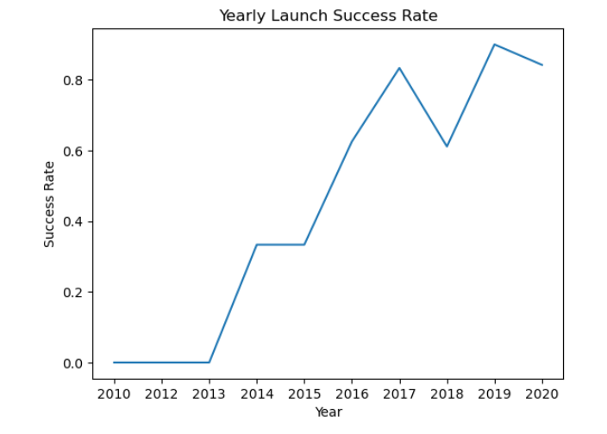
EDA with Data Visualization
Scatter plots were created to assess the relationship between flight number and other variables like orbit type. A bar chart was plotted to determine the relationship between the type of orbit and the success rate. A line chart was used to capture yearly success rate of launches trend.
Link to Notebook is https://github.com/AmmanSajid1/IBM-Data-Science-Capstone-SpaceX-Project/blob/main/EDA%20and%20Visualisation.ipynb

Slide 12
EDA with SQL
The data was uploaded into a PostgreSQL database from within the Jupyter Notebook using SQL magic commands and SQLite Python library. Queries were run to gain insight from the data. The following questions were answered using SQL queries:
The names of unique launch sites in the space mission.
The total payload mass carried by boosters launched by NASA (CRS)
The average payload mass carried by booster version F9 v1.1
The total number of successful and failure mission outcomes
The failed landing outcomes in drone ship, their booster version and launch site names.
The link to the Notebook is

Slide 13
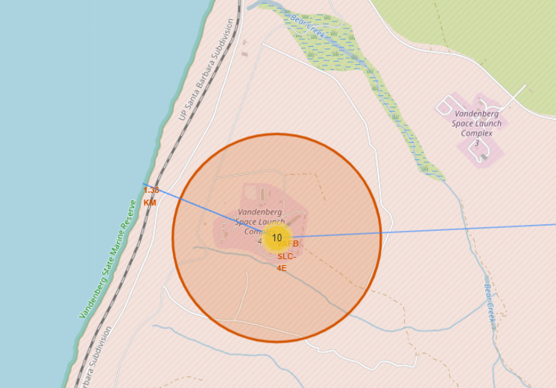
Build an Interactive Map with Folium
All launch sites were marked using map objects such as markers, circles and lines to mark the success or failure of launches for each site on the folium map. The circle marks allowed for users to quickly see where the sites were located.
Using the color-labeled marker clusters, launch sites with relatively high success rate were identified. The lines were used to emphasise distance of launch sites between railways, coastlines and highways to answer questions such as:
Are launch sites near railways, highways and coastlines.
Do launch sites keep certain distance away from cities.
The link to the Notebook is https://github.com/AmmanSajid1/IBM-Data-Science-Capstone-SpaceX-Project/blob/main/EDA%20with%20Folium%20Maps.ipynb

Slide 14
Build a Dashboard with Plotly Dash
Built an interactive dashboard with Plotly dash
Plotted pie charts showing the total launches by Site with a drop down option to choose all or specific sites.
Plotted scatter graph showing the relationship between Outcome and Payload Mass (Kg) for the different booster versions with a slider to adjust payload mass range.
The plots allowed for observations and relationships to be discovered between payload mass and site launch location on outcome success.
The link to the Dash App Python file is https://github.com/AmmanSajid1/IBM-Data-Science-Capstone-SpaceX-Project/blob/main/app.py

Slide 15
Predictive Analysis (Classification)
The data was loaded and transformed using numpy and pandas and was split into training and test sets using the scikit-learn library.
Different machine learning models for classification were used (e.g. Logisitic Regression, Decision Tree, K Nearest Neighbour (KNN) etc). These were trained using the training data and the hyperparameters associated with each model were tuned using GridSearchCV to maximise performance of each model.
Accuracy was used as the evaluation metric for the models.
The best performing classification model was chosen.
The link to the notebook is https://github.com/AmmanSajid1/IBM-Data-Science-Capstone-SpaceX-Project/blob/main/Machine%20Learning%20Model%20Training.ipynb

Slide 16
Results
Exploratory data analysis results
Interactive analytics demo in screenshots
Predictive analysis results

Slide 17

Section 2

Slide 18
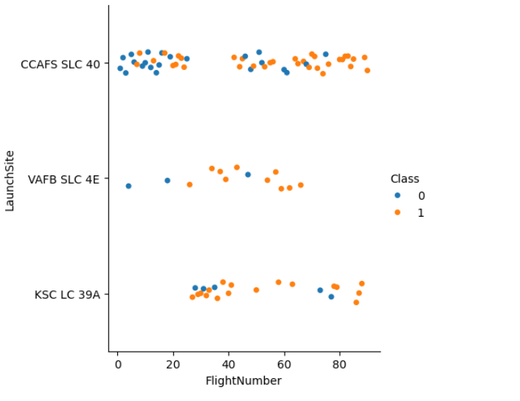
Flight Number vs. Launch Site
From the scatter plot we can see that as the number of flights at a launch site increases, the greater the number of successful landings.

Slide 19
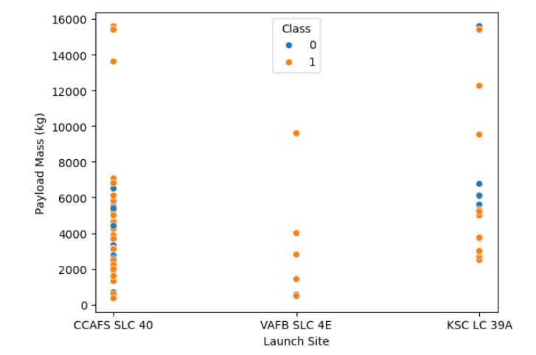
Payload vs. Launch Site
The heavier payloads at CCAFS SLC 40 tend to have successful landings.
VAFB SLC 4E does not have a payload mass higher than 10,000kg

Slide 20
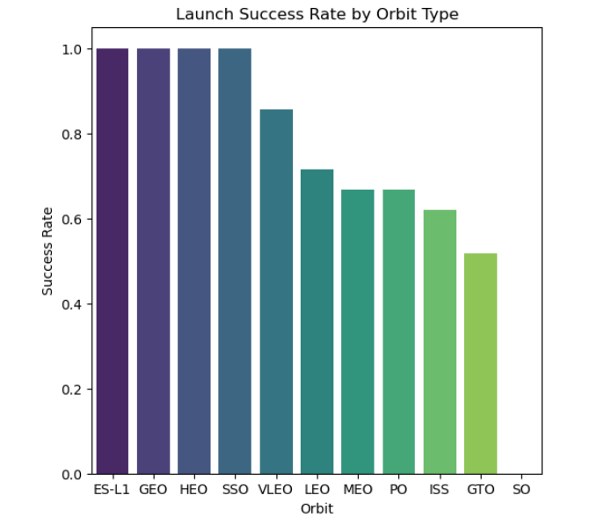
Success Rate vs. Orbit Type
From the bar chart we can see that ES-L1, GEO, HEO, SSO and VLEO orbits have the highest success rate at 100%
Also worth mentioning that ES-L1, GEO and HEO have only one launch occurrence in the dataset whereas GTO has 27 launches with 50% having successful booster landings.

Slide 21
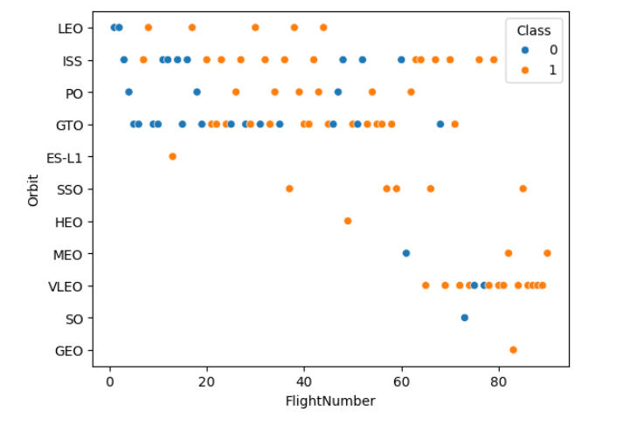
Flight Number vs. Orbit Type
The plot below shows the Flight Number vs. Orbit type. We observe that in the LEO orbit, success is related to the number of flights whereas in the GTO orbit, there is no relationship between flight number and the orbit.

Slide 22
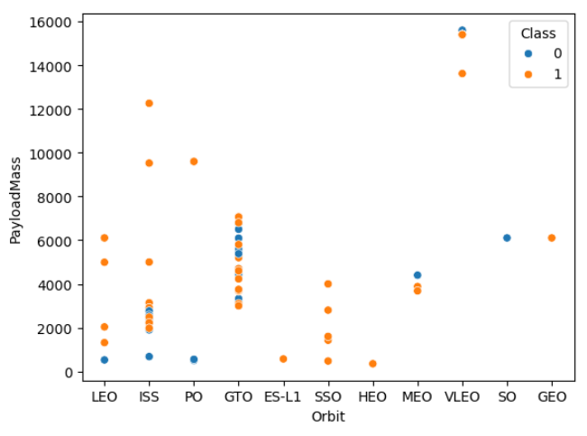
Payload vs. Orbit Type
We can observe that with heavy payloads, the successful landing are more for PO, LEO and ISS orbits.

Slide 23
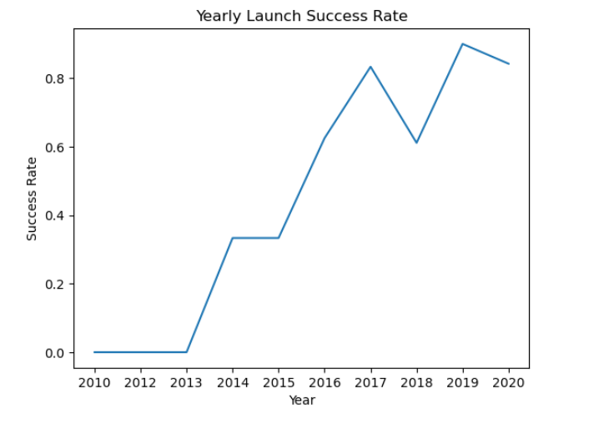
Launch Success Yearly Trend
From the plot, we can observe that success rate since 2013 kept on increasing till 2020 with some flat out during 2014 and slight dip in 2018.

Slide 24
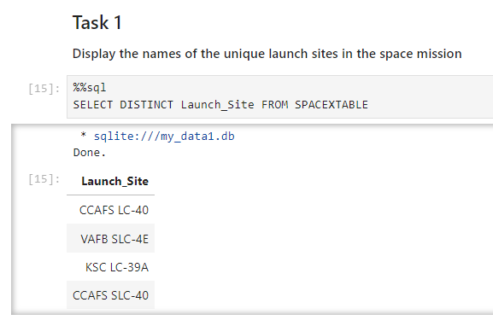
All Launch Site Names
The DISTINCT key word was used to show only unique launch sites from the SpaceX data.
There is data for four launch sites in the dataset.

Slide 25
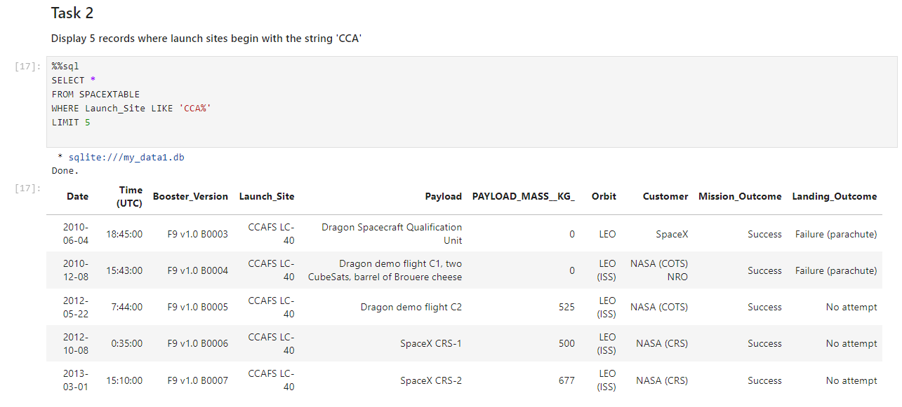
Launch Site Names Begin with 'CCA'
The query returns 5 records from the SpaceX dataset with Launch Site names that begin with 'CCA'

Slide 26
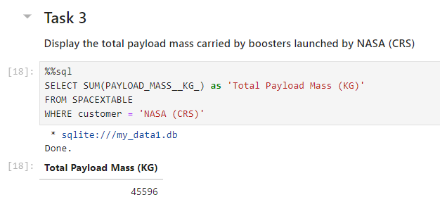
Total Payload Mass
We can see that the total payload mass carried by boosters launched by NASA (CRS) is 45,596 Kg

Slide 27
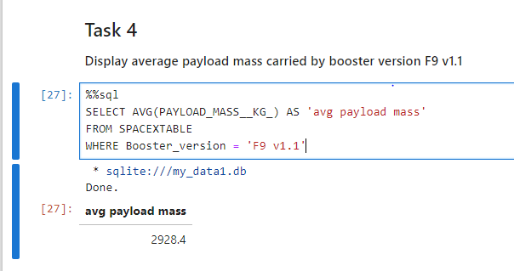
Average Payload Mass by F9 v1.1
The query shows that the average payload mass (kg) carried by booster version F9 v.11 is just over 2.9 Tonnes.

Slide 28
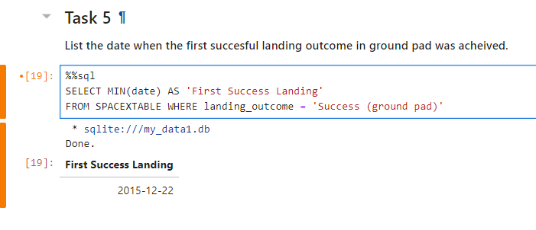
First Successful Ground Landing Date
The first successful landing for SpaceX happened on 22nd December 2015!

Slide 29
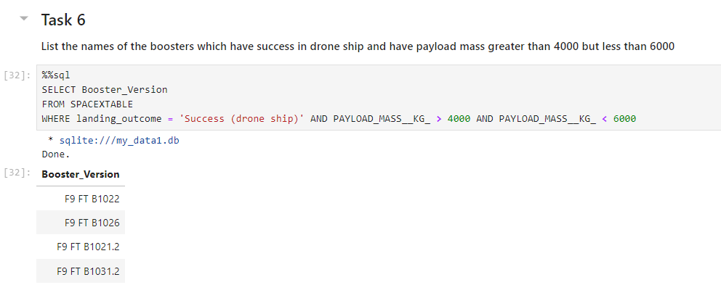
Successful Drone Ship Landing with Payload between 4000 and 6000
The query returns the booster versions that have successfully landed on drone ships for missions where they carried a payload between 4000 and 6000 kg.

Slide 30
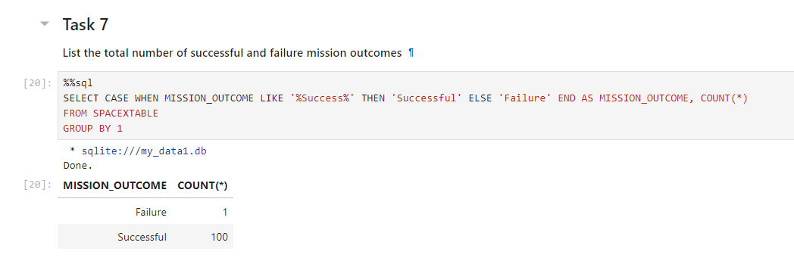
Total Number of Successful and Failure Mission Outcomes
We can see that SpaceX only failed 1 mission out of 101 total missions!
Very impressive!
Note that mission success doesn't necessarily mean the booster landed safely for reuse

Slide 31
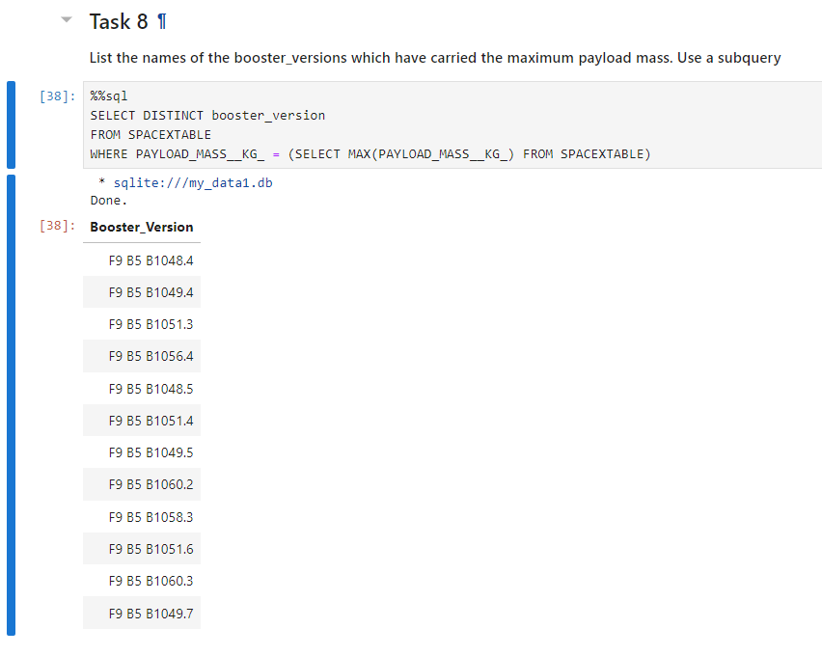
Boosters Carried Maximum Payload
The query shows that there have been 12 different booster versions that have carried the maximum recorded payload mass (kg) in the dataset.

Slide 32
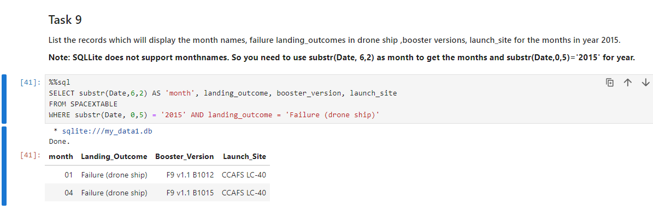
2015 Launch Records
The query shows that there was two launches in 2015 where the booster failed to land on a drone ship

Slide 33
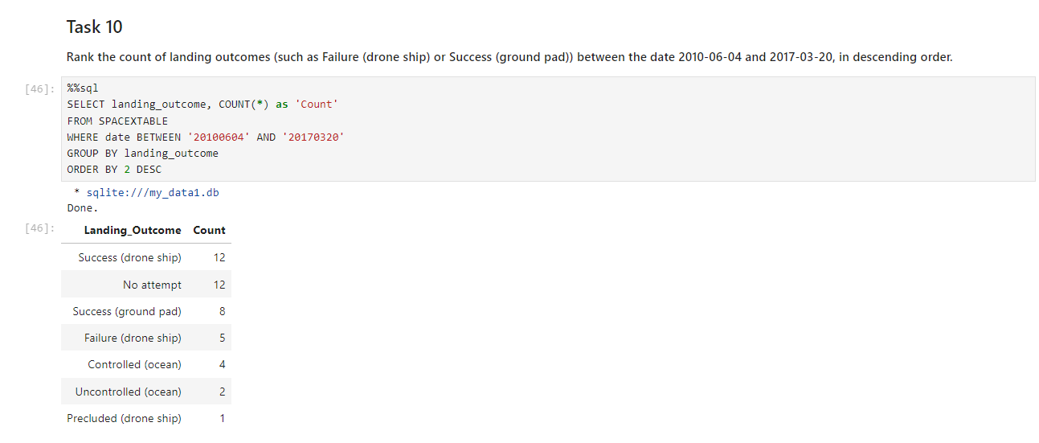
Rank Landing Outcomes Between 2010-06-04 and 2017-03-20
The query shows that between the dates shown there have been a significant number of successful booster landings, although there is also a substantial number of no attempts.

Slide 34

Section 3

Slide 35
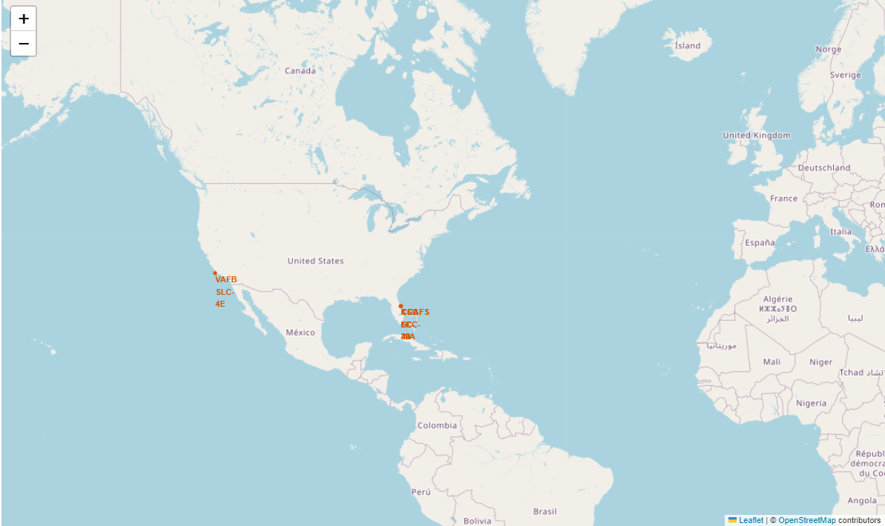
All Launch Sites on Global Map
We can see that the launch sites are located in the United States of America, particularly on the East and West coasts.

Slide 36
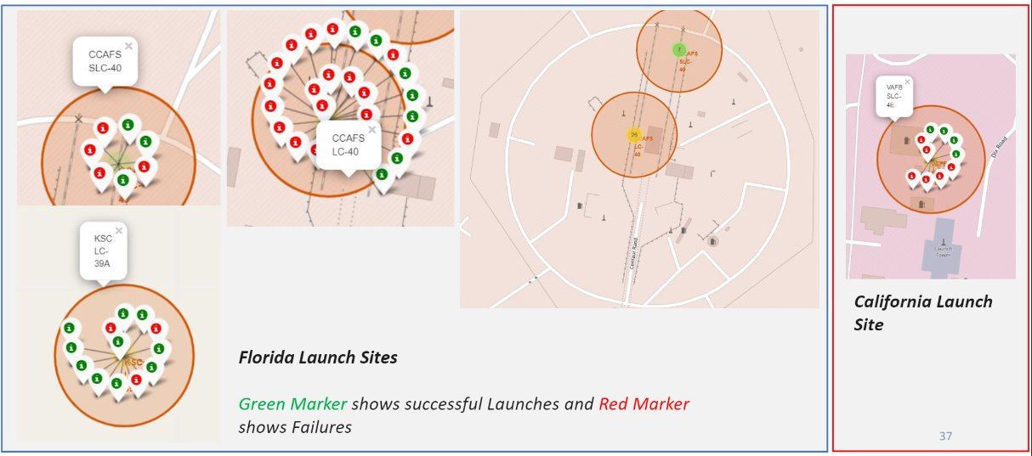
Successfull Launches by Site on Global Map

Slide 37

Launch Site Distance to Landmarks

Slide 38

Section 4

Slide 39

Successfull Launch Rate by Site Pie Chart

Slide 40

Site with Highest Success/Failure Launch Ratio

Slide 41
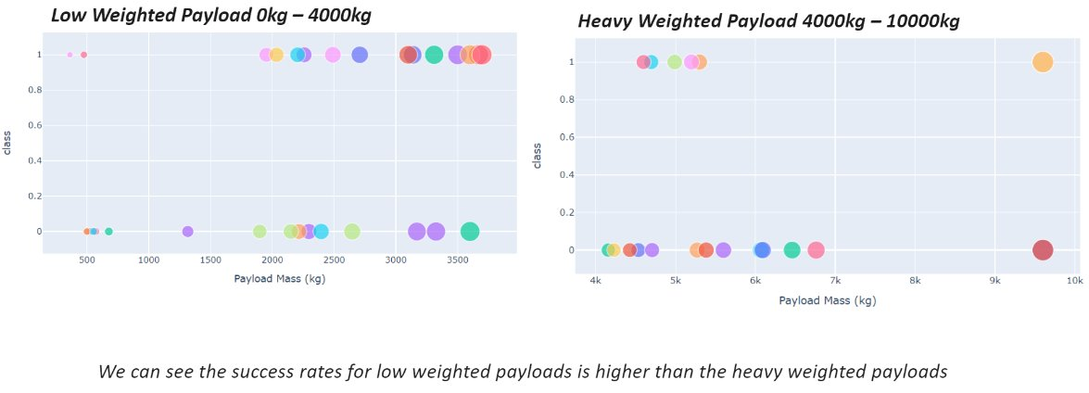
Scatter plot of Payload vs Launch Outcome for all sites, with varying payload

Slide 42

Section 5

Slide 43
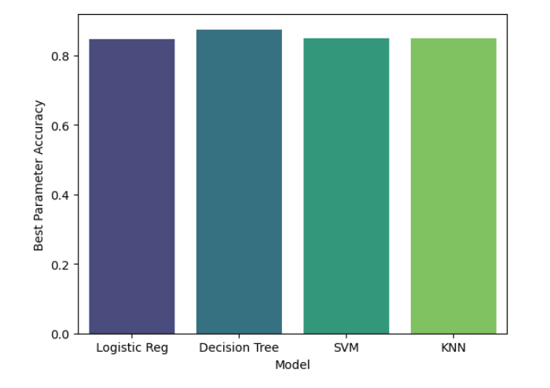
Classification Accuracy
We can see that Decision Tree Classifier performed best out of all the trained machine learning models.

Slide 44
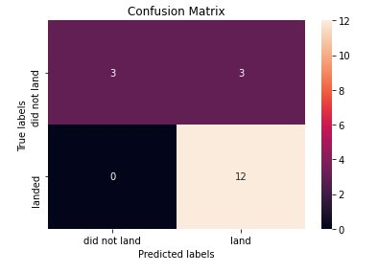
Confusion Matrix
The confusion matrix for the decision tree classifier shows that the classifier can distinguish between the different classes. The major problem is the false positives .i.e., unsuccessful landing marked as successful landing by the classifier.

Slide 45
Conclusions
We can conclude that:
The larger the flight amount at a launch site, the greater the success rate at a launch site.
Launch success rate started to increase in 2013 till 2020.
Orbits ES-L1, GEO, HEO, SSO, VLEO had the most success rate.
KSC LC-39A had the most successful launches of any sites.
The Decision tree classifier is the best machine learning algorithm for this task.

Slide 46


